Slide 1
Stylometric authorship attribution: A Detective ROMANCE
Patrick Juola, Ph.D.
Lauritis Professor of Teaching and Technology
Mathematics and Computer Science Department
Duquesne University, Pittsburgh, PA

Slide 2
About myself
My degree reads “computer science”
But like most DH practitioners, I’m pretty interdisciplinary
I’m a forensic scientist, specifically a stylometrist
(You’re, a… What?)
I also read a lot of detective novels…

Slide 3
What does this have to do with digital editions?
Common to scholarship generally, whether computer science, forensic science, or scholarly publishing
We have a mass of “stuff,” some of it possibly even correct, and our task is to make sense of it and present it in a clear and cogent manner.

Slide 4
Investigation and evidence
Evidence is key to any investigation
Useful even (especially?) before trial
But only if it is what it purports to be
E.g., R. Austin Freeman wrote a detailed analysis of how to forge a fingerprint in 1905(!)
First question for any evidence: is it genuine?

Slide 5
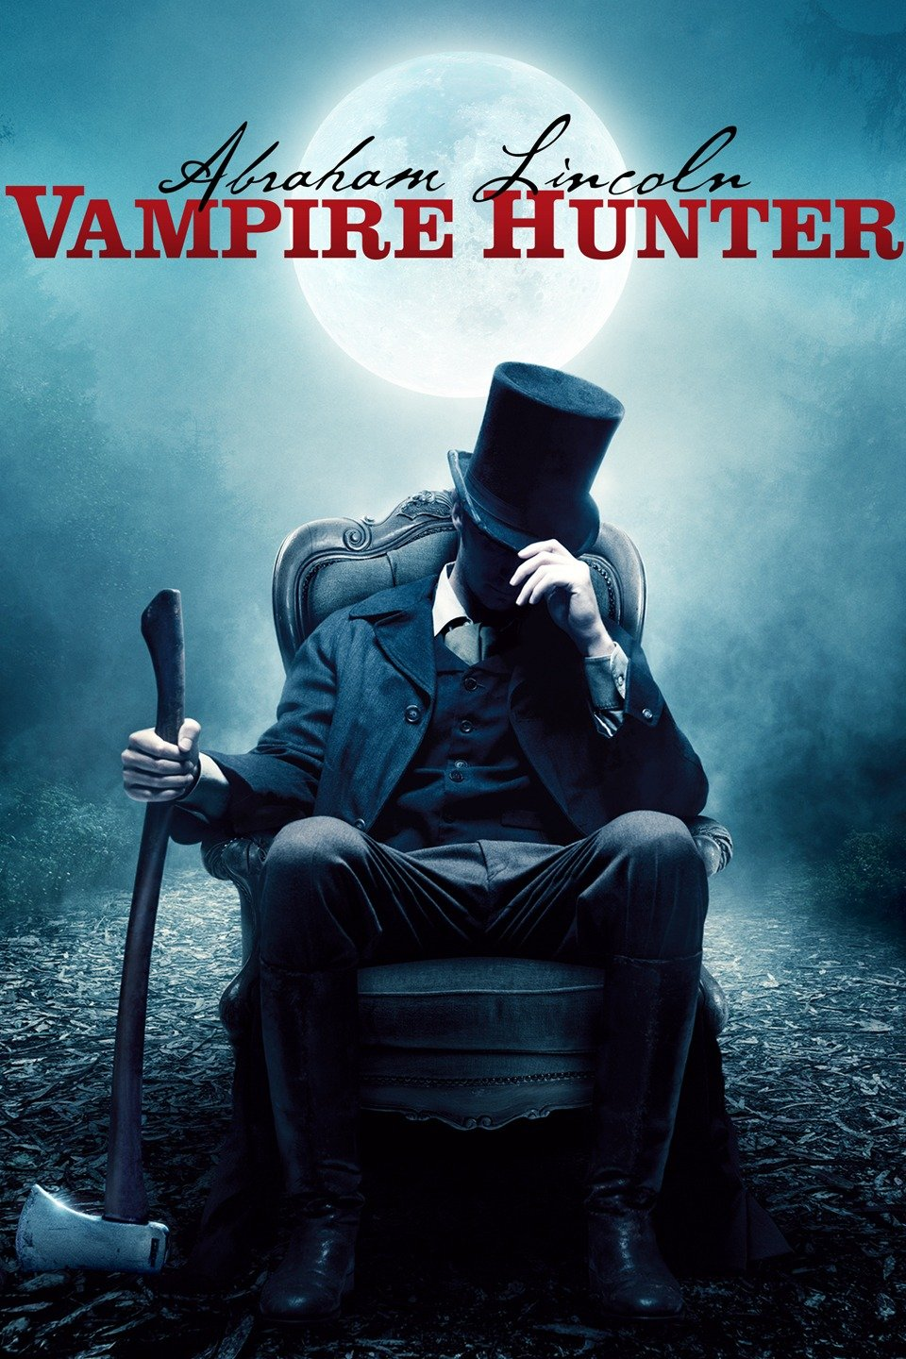
True for non-forensics as well
If you’re writing a biography of Abraham Lincoln, you want to know what really happened.
This might not be an authentic source.

Slide 6
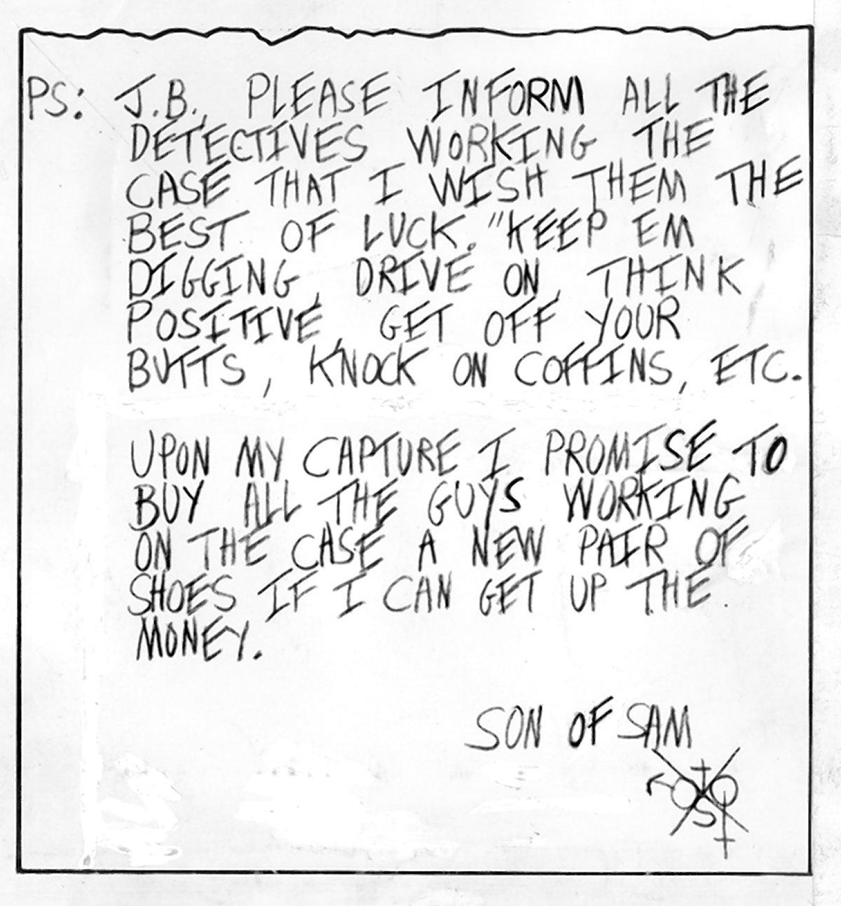
Questioned documents
… are a basic fact of life
… in fiction
… in scholarship
… and reality
“Who wrote this?”
Notes:
Second ”Son of Sam” letter (May 30, 1977). David Berkowitz killed eight people in NYC between July 1976 and July 1977.

Slide 7
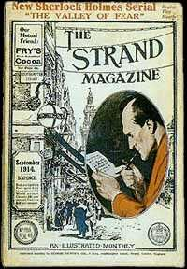
“Mysterious Note” – in fiction
In Conan Doyle’s The Hound of the Baskervilles, Sir Henry Baskerville receives a note (made from words clipped from the newspaper) warning him “away from the moor.”
But who wrote it?

Slide 8
Mysterious notes in scholarship
The Epistle to the Hebrews
The Donation of Constantine
The Federalist Papers
Vortigern, Shakespeare’s lost play
The Hitler Diaries
Primary Colors

Slide 9
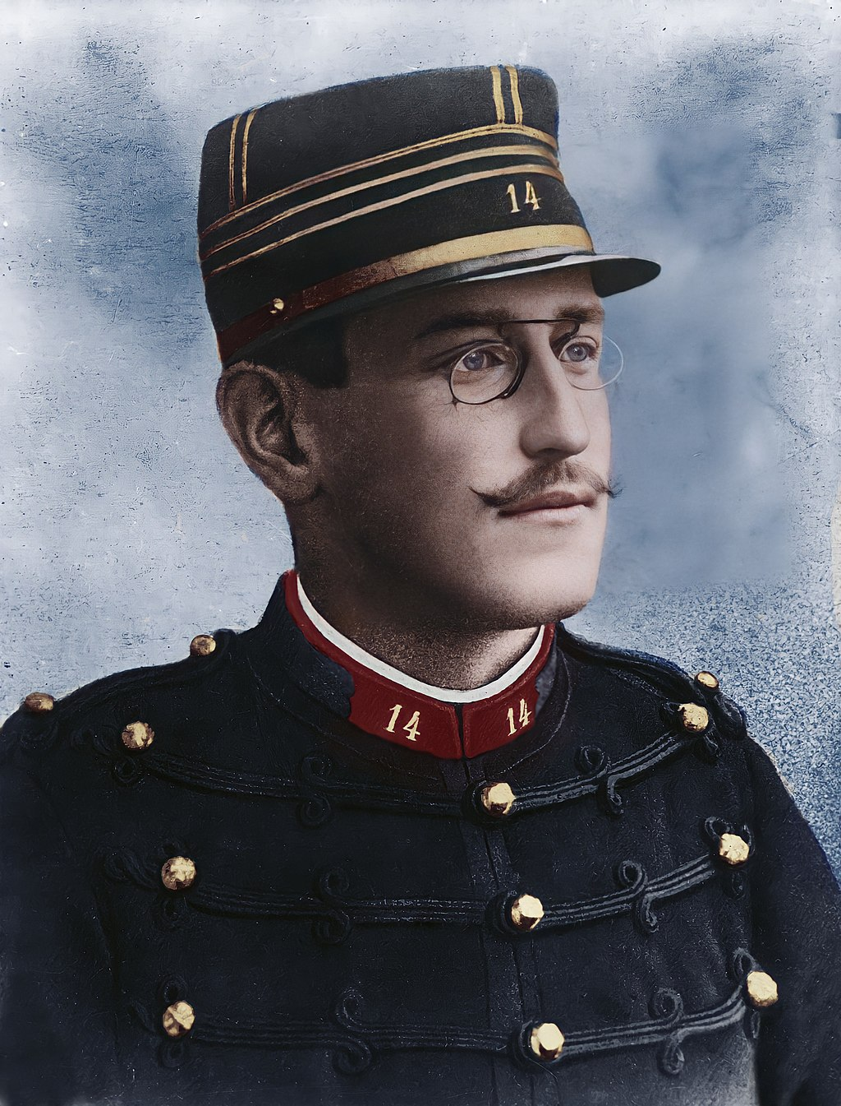
Mysterious notes in forensics
L’Affaire Dreyfus
Derek Bentley’s forged confession
The Unabomber Manifesto
The Jon Benet Ramsey ransom note
Ceglia v. Zuckerberg

Slide 10
Questioned Documents
Documentary evidence is important (increasingly so as we move online)
Some crimes (forgery, document fraud, libel*) can only be committed via documents
Whole section of AAFS devoted to the physical examination of “questioned documents”

Slide 11
Is the suicide note real?
J.D. : Um... 'to me, though, suicide is the natural answer to the myriad of problems life has given me'.
Veronica Sawyer : That's good but Heather would never use the word myriad.
J.D. : This is the last thing she'll ever write; she'll want to use as many 50-cent words as possible.
Veronica Sawyer : She missed 'myriad' on the vocab test two weeks ago.
J.D. : That only proves my point more. The word is a badge for her failures at school.

Slide 12
In real life (Chaski, 1995)
You walk into a room, and there is your roommate’s dead body lying on the floor, with a suicide note on the computer, typed in MS-Word.
Suicide or cunningly-concealed murder?

Slide 13
Dealing with these notes
Traditionally, the realm of handwriting experts (today: FDE’s)
Can also involve typewriter experts
However, modern documents (email, web pages, SMS) don’t have “handwriting”
Any one 12pt Times Roman “A” looks identical to any other.
What clues to authorship exist? How can we analyze such notes?

Slide 14
Basic approach (stylometry)
“Language most shows a man; speak, that I may see thee.” (Jonson, 1640)
“Then said they unto him, say ‘Shibboleth’: and he said ‘Sibboleth,’ for he could not frame to pronounce it right. Then they took and slew him at the passages of Jordan.” (Judges 12:6)

Slide 15
Sometimes it’s obvious
Back to the suicide note:
If it’s in German, it wasn’t me.
I know how to spell my own name.
I have my own verbal tics, not anyone else’s.

Slide 16
Not so obvious?
The dead roommate is named Angus Euan McScottishGuy, native to Glasgow.
The note is dated 5/27/22 and reads, in part, “I have been dishonored by my poor grades; the only way out is to take poison or throw myself under a semi.”
Anyone see any issues with this?

Slide 17
Analyzing the suicide note
The note is dated 5/27/22 and reads, in part, “I have been dishonored by my poor grades; the only way out is to take poison or throw myself under a semi.”
British writing:
Dates are written D/M
“dishonored” should have a ‘u’
Students receive “marks”, not “grades”
Goods are transported in “lorries,” not trucks and certainly not “semis”.
Lots of reasons for suspicion here

Slide 18
Individual minds become individual writings
Every person in this room thinks and acts slightly differently from every other one.
We have different interests,
… different backgrounds,
… different personalities,
… different aptitudes
All of which are reflected in language

Slide 19
About me:
I was born in Seattle, WA, and grew up in Idaho/Oregon
I speak “Pacific Northwest”
“High muckamuck” – important person
“cougar” – mountain lion (Puma concolor)
... but not perfectly
4 years in mid-Atlantic
7 in Colorado
3 in UK (Oxford)
20+ in Pittsburgh

Slide 20
Language as habits
The underlying linguistic theory is that all speaker/writers of a given language have their own personal form of that language, technically labeled an idiolect. A speaker/writer's idiolect will manifest itself in distinctive and cumulatively unique rule-governed choices for encoding meaning linguistically in the written and spoken communications they produce.
For example, in the case of vocabulary, every speaker/writer has a very large learned and stored set of words built up over many years. Such sets may differ slightly or considerably from the word sets that all other speaker/writers have similarly built up, in terms both of stored individual items in their passive vocabulary and, more importantly, in terms of their preferences for selecting and then combining these individual items in the production of texts.

Slide 21

Vocabulary habits
What is this?
Is this a couch?
Is this a sofa?
Is this a davenport?
Is this a chesterfield?
Is this a divan?
Is this a settee?

Slide 22
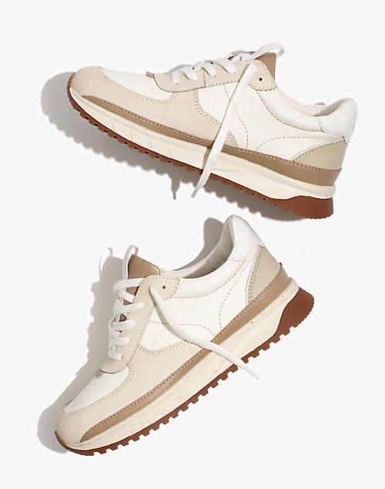
Vocabulary habits (2)
What are these?
Sneakers?
Trainers?
Running shoes?
Plimsolls?
Athletic shoes?

Slide 23
In real life (Shuy, 2001)
Kidnapping case; primary evidence was ransom note
“No Kops! Come alone!! […] Put it in the green trash kan on the devil strip at the corner 18th and Carlson.”
Disregard misspellings; anyone can deliberately fake illiteracy
What on earth is a “devil strip”?

Slide 24
Devil strip
The patch of grass between the sidewalk and the street
What do you call it?
Called “devil strip” in Akron, OH

Slide 25
In real life (2) (Wellman, 1936)
Found the word “toutch” in several disputed documents
Asked witness to write down dictated sentences, one included “touch”
Witness spelled it as “toutch”
Offered (and accepted) as evidence that witness had written documents

Slide 26
Can work on phrases, too
Any 7+ word phrase in English is likely to be unique
“My orange cat likes to eat fish”
0 hits on Google as of 1 April 2021
“My orange cat likes to eat tuna”
“My orange cat loves eating tuna fish”
“My ginger cat loves eating tuna fish”
Find a 7+ word phrase in common and you’ve proven* common authorship

Slide 27
In real life (3)
Chevron Corp v. Donziger (2014)
Allegedly fraudulent decision; judge illegally substituted a decision ghost-written by plaintiffs in Ecuadorean court.
Leonard/Juola analysis found nearly 40 lengthy phrases in decisions that were on the ghostwriter’s hard drive (and not in the record)

Slide 28
When it works, it’s great
But it doesn’t always work. How often do you write about “touch,” regardless of you spell it?
Corpus studies estimate once/100,000 words.
We need something more common and stable

Slide 29
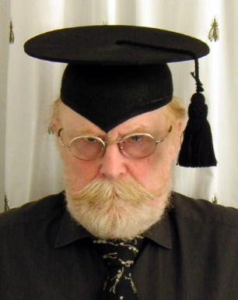
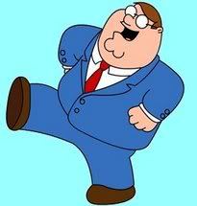
Another type of cue
The paradigmatic and systematic utilization of sesquipedalian lexical items can be an informative element of individual and idiosyncratic patterns of linguistic variation
Or, some people use big words

Slide 30
Word length as cue
“Try to balance in your own mind the question whether the latter [text] does not deal in longer words than the former [text]…. Some of these days spurious writings will be detected by this test.” (August de Morgan, 1851)
Formally, calculate average word length and use first-semester stats (t-tests)

Slide 31
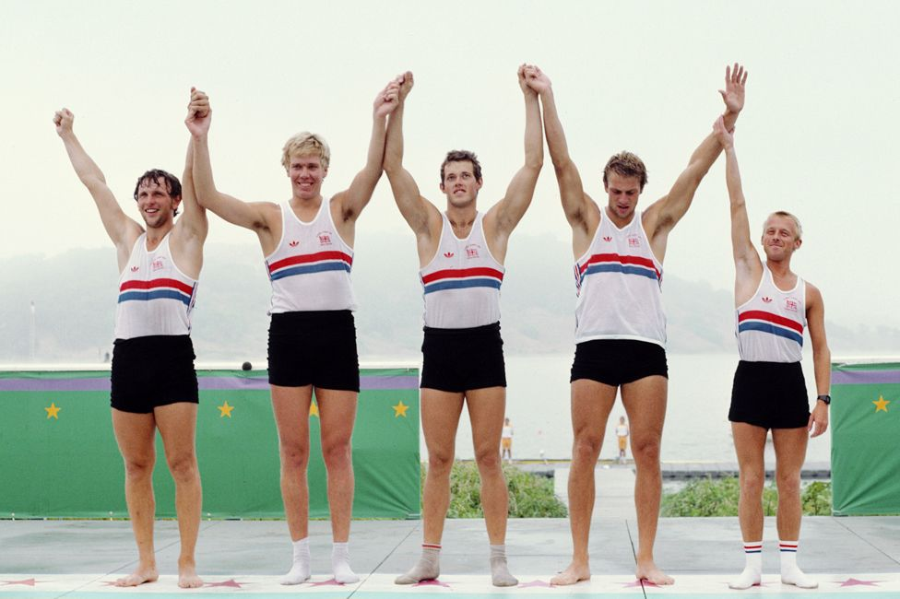
The issue
Average word length is,… so-so.
Like classifying people by height—almost everyone is average
AWL isn’t stable, either. I write differently to friends than to journals.
If AWL won’t work, what else will?

Slide 32
One solution
A pair of eights is not the same as a six and a ten
Don’t use averages
Use multiple indicators separately
Even if the suspect is average in one way, he’s probably unusual in another

Slide 33
Histograms of “features”
Look at each length separately
Can also be applied to other features than simple lengths
Parts of Speech
Common words
Punctuation
Use stats to combine

Slide 34
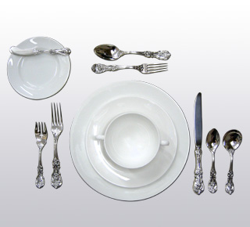
An interesting feature set
Where is the dinner fork?
“next to” the plate?
“to the left of” the plate?
“on the left of” the plate?
“at the plate’s left”?
“left of” the plate?
“right of” the salad fork?
Or simply between the salad fork and plate?

Slide 35
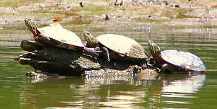
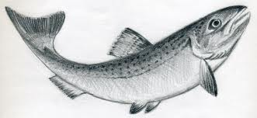
Look at this slide
Three turtles
sat on a log
and a fish
swam under them.

Slide 36
… and tell me what changed
Three turtles
sat on a log
and a fish
swam under it.

Slide 37
Common words
Strongly associated with “function” or “closed-class” words.
Common (so lots of data)
Little meaning (so lots of room for variation)
Psycholinguistically “light,” so largely ignored at a very fundamental level of processing. (See Bransford, et al., 1972) People focus on meaning, not form.

Slide 38
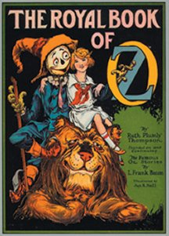
Literary: The Case of Oz XV

Slide 39
Historical synopsis
Baum wrote The Wonderful Wizard of Oz in 1900; 13 more books by 1919.
15th book (“Royal Book”) unfinished at his death, Ruth Plumly Thompson took “fragmentary draft” and “unfinished notes” to complete and publish
Published 1921 with Baum’s name on cover, “enlarged and edited” by Thompson

Slide 40
Historical synopsis
Or was it?
Alternate view: “Royal Book” was entirely Thompson’s work. Story about “unfinished notes” and Baum’s name created by publisher to strengthen sales.
Thompson went on to publish nearly 20 more Oz books under her own name.

Slide 41
Binongo (2003) analysis
Collect 50 “most frequent words”
Candidates include the, of, and, to, not, as, with, before, after, some, well, back, how
N.b., very “light” words
Apply stats (PCA) to perform “dimensionality reduction,” essentially making 2D image from 50D data.

Slide 42
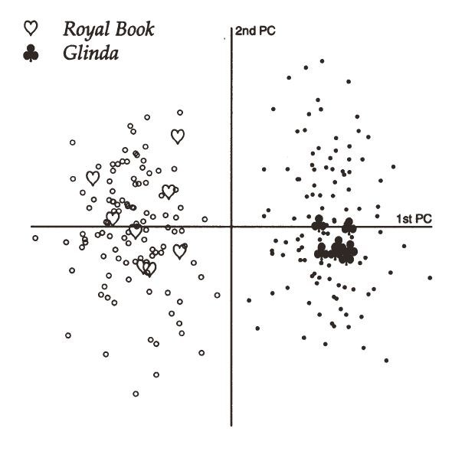
Baum is on right
So who wrote Royal Book?

Slide 43
In real life (Juola, 2012)
I’m afraid I can’t disclose much about this one…..
Disputed will
Analysis showed more similar vocabulary and more similar MWF vocabulary to claimant than to other testator writings
My conclusion was that the will was forged

Slide 44
In real life (2) (Grant, 2013)
2009 fire; woman (AB) died
Physical evidence was suspicious
Text messages sent by AB seemed to prove she was alive that evening
“Shift in texting style” at 12:07pm
“Xxx” and “xxx” became “X x”
Were later messages sent by AB or her husband CB? Was AB already dead?

Slide 45
SMS vocabulary differs
Feature | Use by CB | Use by AB
“ad” for “had” | 0 | 13
“dont” for “don’t” | 0 | 9
“t” for “the” | 1 | 15
“w” for “with” | 3 | 10
“dnt” for “don’t” | 8 | 0
“jst” for “just” | 12 | 0
“wiv” for “with” | 15 | 0
“4” for “for” (no space) | 35 | 0

Slide 46
Grant’s analysis
18 features of known documents hand-identified
Look for these features in questioned documents:
Will do when i wake up, so tired. Need talk 2 chris. Still hav feelins 4him. X
Grant concluded later messages inconsistent with AB’s style; CB later admitted setting fire and killing AB

Slide 47
“Case half solved”
Method works by comparing “closeness” of documents
More similar = “close” = more likely
“Closed-class problem”: select the locked-room suspect
“Open-class problem”: How about none-of-the-above?

Slide 48
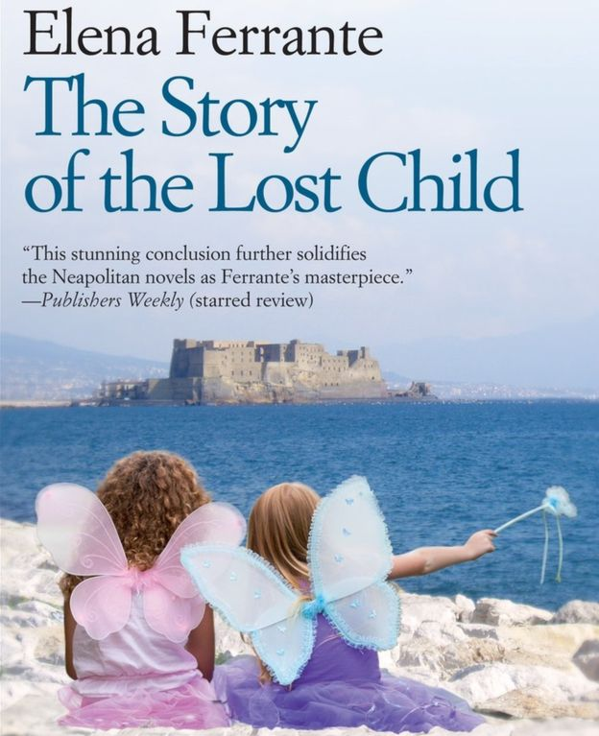
Literature often open-class
Who is Elena Ferrante?
Longlisted (2016) for Booker Prize
Known to be pseudonym, but for whom?
Is “Elena” even a woman?
Typical English scholarship questions

Slide 49
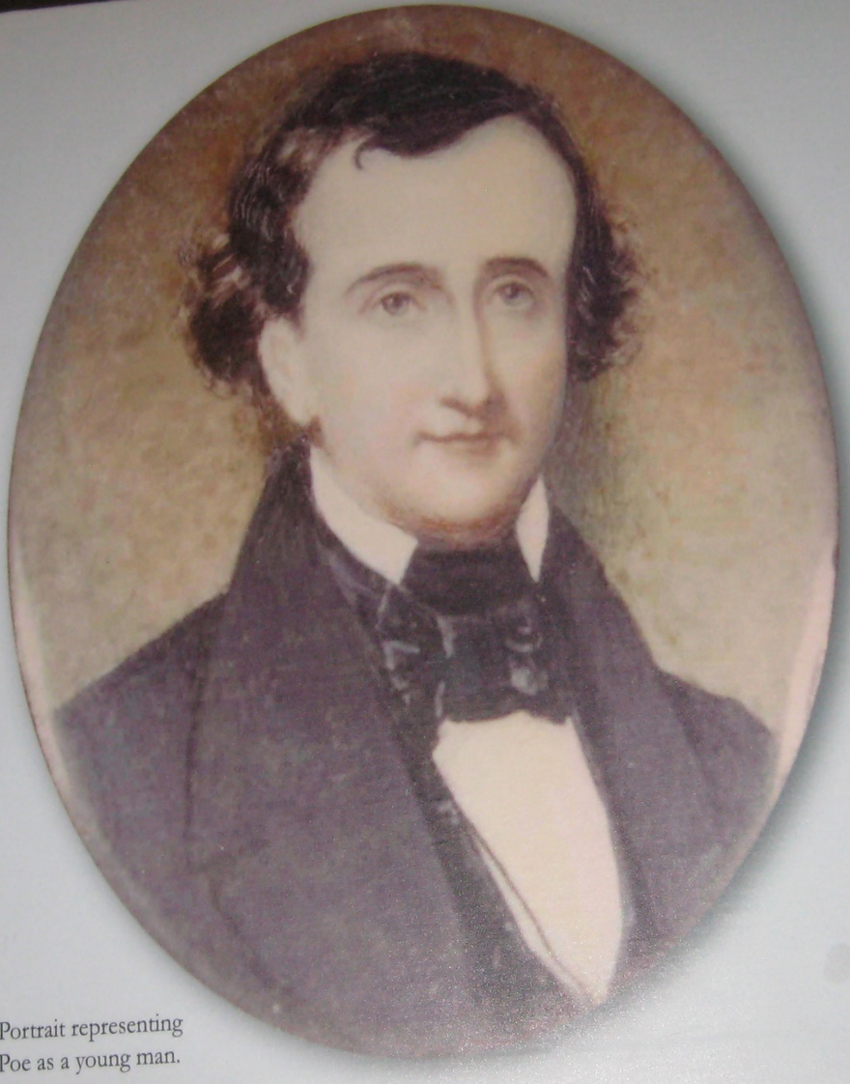
Poe’s early work?
Analysis by Paul Collins (2013)
Two prose works (1826)
Author listed as Henry Poe (W. H. P.)
Collins argues thematic and stylistic similarity to Edgar Allan’s work
Computational analysis (JGAAP) confirms: earliest known published prose by E.A.P.

Slide 50
Some well-known cases
The Federalist Papers
The “Unabomber Manifesto”
Joe Klein’s Primary Colors
Rowling’s The Cuckoo’s Calling
Ceglia v. Zuckerberg

Slide 51
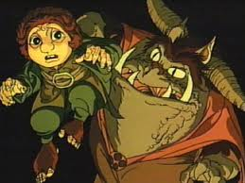
One of my cases (w/changes)
Bilbo Baggins, a native of Mordor
Anonymous on-line (newspaper) critic of Mordor government
Applying for asylum in United States
How to address his claim?

Slide 52
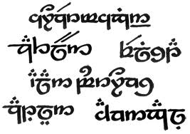
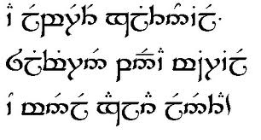
Evidence offered
~10 signed articles (photocopies) from Mordor newspaper
~11 unsigned articles (web pages) from online paper
If not him, who?

Slide 53
Key insight: ad-hoc KDs
If it could be anyone, let it be anyone!
Bilbo’s writing will be most like his own!
5 named authors from political columns of online Elvish language newspaper
160 news articles, at least thirty articles per author

Slide 54
Two expected scenarios
Yes
Bilbo closer than any competitor
No
Rando off the street closer than Bilbo
Bilbo
Distractor #1
Distractor #2
Distractor #3
Distractor #4
Distractor #5
Distractor #1
Distractor #2
Distractor #3
Bilbo
Distractor #4
Distractor #5

Slide 55
Working hypothesis
If Baggins were NOT the author of the questioned documents, there is only 1/6 chance he (KD) would be the closest author among the total author set to the QD
Strengthen with multiple analyses
1 analysis = 1/6
2 analyses = 1/(6x6)
5 analyses = 1/(6x6x6x6x6) = YAHTZEE!

Slide 56
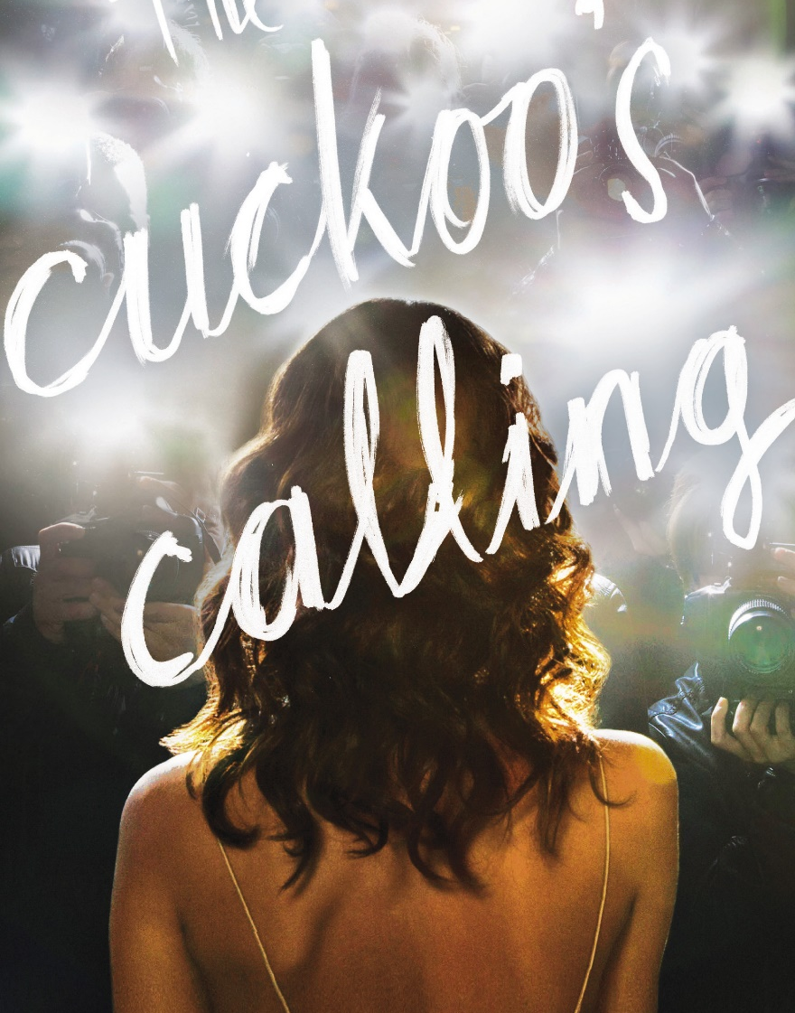
The Cuckoo’s Calling
Published April 30, 2013
Author named as Robert Galbraith
Acknowledged pseudonym
Outed on Twitter as J.K. Rowling (author of Harry Potter series).
Confirmation or disproof needed by newspaper

Slide 57
Rowling example
Three distractor authors (contemporary female British crime novelists), total 4 candidates
Elimination threshold used of top 2
Four feature sets (word lengths, character 4-grams, word pairs, 100 most common words)
Only Rowling not eliminated among candidates

Slide 58
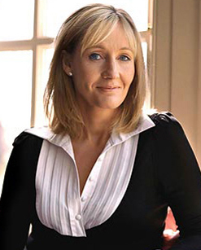
Rowling example (2)
How about none-of-the-above?
If Rowling not author, chances of being in top 2 are 50% (2 of 4)
Chances of being in top 2 4 times in a row are one in 16, about 6%. Conclusion is “unlikely.”
Rowling acknowledged authorship 13 July 2013

Slide 59
Software support
JGAAP : Java Graphical Authorship Attribution Program
General-purpose analysis program
To be demonstrated
Envelope : Proprietary J&A program to extend JGAAP to open-class verification
BC: Proprietary J&A scalable phrasal overlap finder

Slide 60
JGAAP
NSF-funded open-source freeware for authorship analysis experiments
Offers many different choices for language experiments.
Let’s play with it, shall we?

Slide 61
Thank you! Any Questions?

